Slide 1

Interactive 3D Experience
Lesson 6:
Git Conflicts
Elyas Chua-Aziz
cel9@np.edu.sg
Diploma in IM
October 2021

Slide 2
Conflicts in Git
When doing collaborative work, it is inevitable that we encounter file conflicts with our peers.
With Github Desktop, there are a few simple approaches we can use to help make resolving those conflicts an easier experience.

Slide 3
Learning Objectives
Stash conflicted changes when pulling from a repository.
Restore the conflicted changes and resolve the conflicts.

Slide 4
Types of Files
Before we look at file conflicts, we must look at the two different types of files when developing a Unity project:
Binary files
These are files that do not contain code.
This means that our Unity scene files, textures, models, animations, etc. will fall under this category.
Non-binary files
These are files that contain lines of code.
Our C# scripts will be considered non-binary files.
How does this affect Git?

Slide 5
Types of Files
For non-binary files, Github Desktop will try to merge the two conflicting files.
The merged result will try to incorporate both versions of the files into a single file.
The result might not necessarily be perfect, but code has a lower chance of being lost.
The result can then be edited to make it better.
When using Git, our binary files will not be able to be merged by the Github Desktop software.
This means that if any conflicts arise, only ONE of the conflicting files will be accepted into the repository.

Slide 6
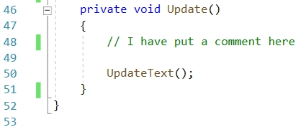
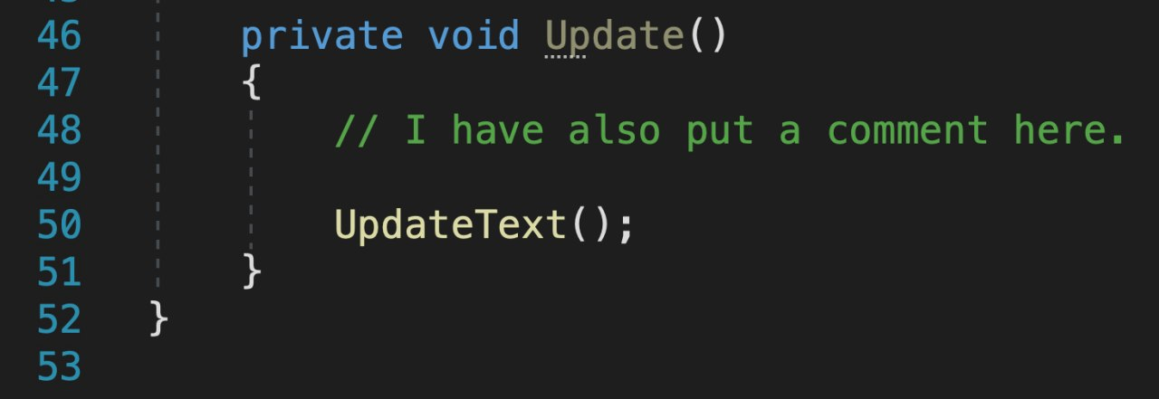
When do conflicts occur?
A conflict occurs when two versions of the same file are being pushed into a repository.
E.g. Christine and Jeremy are trying to edit a file named “Tracker.cs”
They both edit the files separately on their own computers, then try to commit and push the changes.
The person who tries to push LATER will encounter the conflict and will have to resolve it.
This is because the second person must PULL from the repo before they can push their own changes.
Jeremy’s code:
Christine’s code:

Slide 7
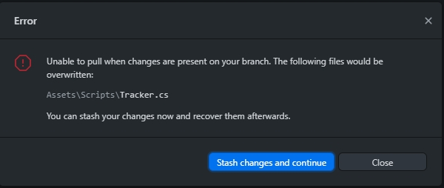
Resolving conflicts
If Jeremy were to try to push his changes after Christine, he would see this when trying to pull:
In his case, Jeremy would first need to stash his changes and pull the file from Christine’s push.
What does it mean to stash a change?

Slide 8
Resolving conflicts
In Git, stashing is the process of keeping a set of changes locally. These changes can be restored (or ‘popped’) at any time.
This helps to keep certain changes safe while resolving other potential conflicts first.
By stashing, Jeremy keeps the code he has written safe while pulling Christine’s code.
He can then restore his stash and allow Github Desktop to try and merge the two files.

Slide 9
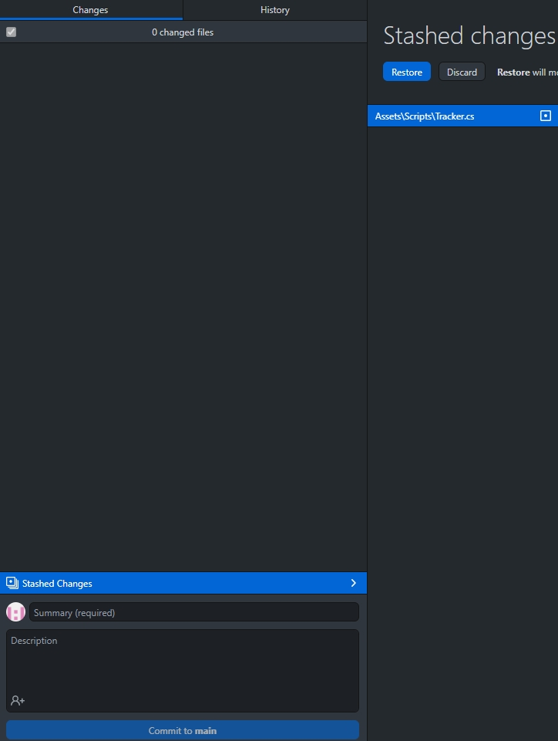
Resolving conflicts
After stashing changes, a new “Stashed Changes” button will appear in the ‘Changes’ tab.
Changes that have been stashed can be viewed by clicking on this button.
Files with changes stashed will be displayed on the right.
They can then be restored by clicking the ‘Restore’ button.
Once ‘Restore’ is clicked, Github Desktop will try merging the files.

Slide 10
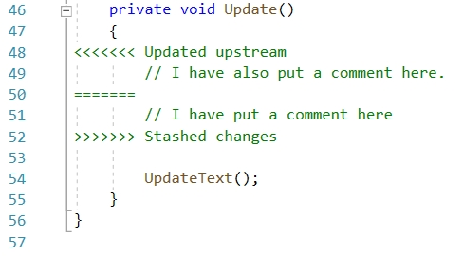
Resolving conflicts
The C# file that had conflicts will now be reloaded in Visual Studio, and we will see that both lines have been merged.
Jeremy and Christine can then argue whose comment should stay in the file.
This process will be the same for lines of code as well, and not just comments.

Slide 11
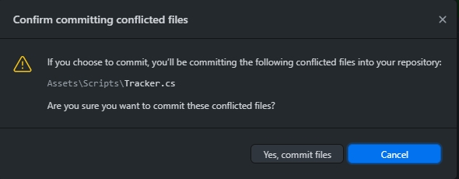
Resolving conflicts
Once the file has been edited, the final correct version can be committed and pushed.
Confirm that you want to commit the file(s), then make a push to the repo.
The conflict will now be resolved and the project group will have the correct file(s).

Slide 12
Resolving conflicts
The above method of resolving a conflict will be used for non-binary files (C# scripts).
Unfortunately, binary file conflicts (images, scene files, etc.) cannot be resolved this way, and the next best method is to:
Rename your file in the project.
Pull from the repository.
Compare your original file with the pulled file and manually resolve before committing and pushing again.

Slide 13
Summary
Conflicts arise when the same file is edited in different ways and pushed to the repository at the same time.
To resolve these conflicts, one member must stash their changes and pull, before restoring the stashed changes and merging the two versions of the file together.
This method works for non-binary files, binary files cannot be merged and only one version can be chosen as the ‘right’ file.

